Slide 1

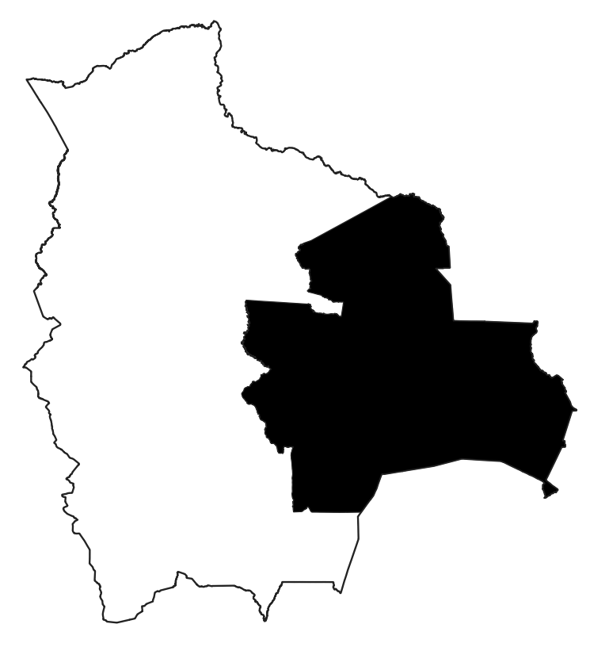


192 MAYV
cases
Immigration event
403 national Japanese from
Ryukyu islands
(refugees from WWII)
Journey on primitive
rail from Brazilian
Coast to Uruma
(Bolivia) on August 1954
Bolivia
Uruma
Located in Nuflo Chavez province, Santa Cruz State, 6 km east of Rio Grande and 37 km north of Puerto Pailas
Dense forest, sandy soil covered with lush
Vegetation. Rainy season (January through
April). Average daytime temperature 24-27 °C
Culex quinquefasciatus was identified In the area

Slide 2



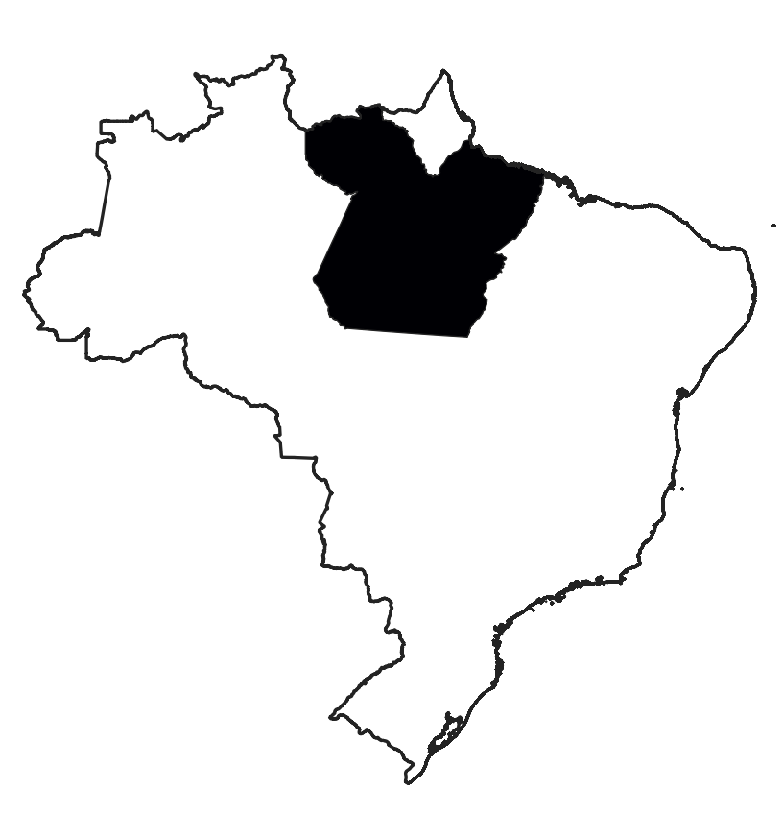


807 MAYV
cases
About 7,000 hectares of rubber plantations in Belterra, Brazil since 1934
4,083 residents in
Belterra in 1978
Brazil
Higher concentration of cases from houses
closest to the forest
Evidence of natural MAYV
Infection in
Haemagogus janthinomynis
Rubber workers required
to enter the forest almost every day
Evidence of natural MAYV
Infection in birds and primates

Slide 3
A
B

Slide 4
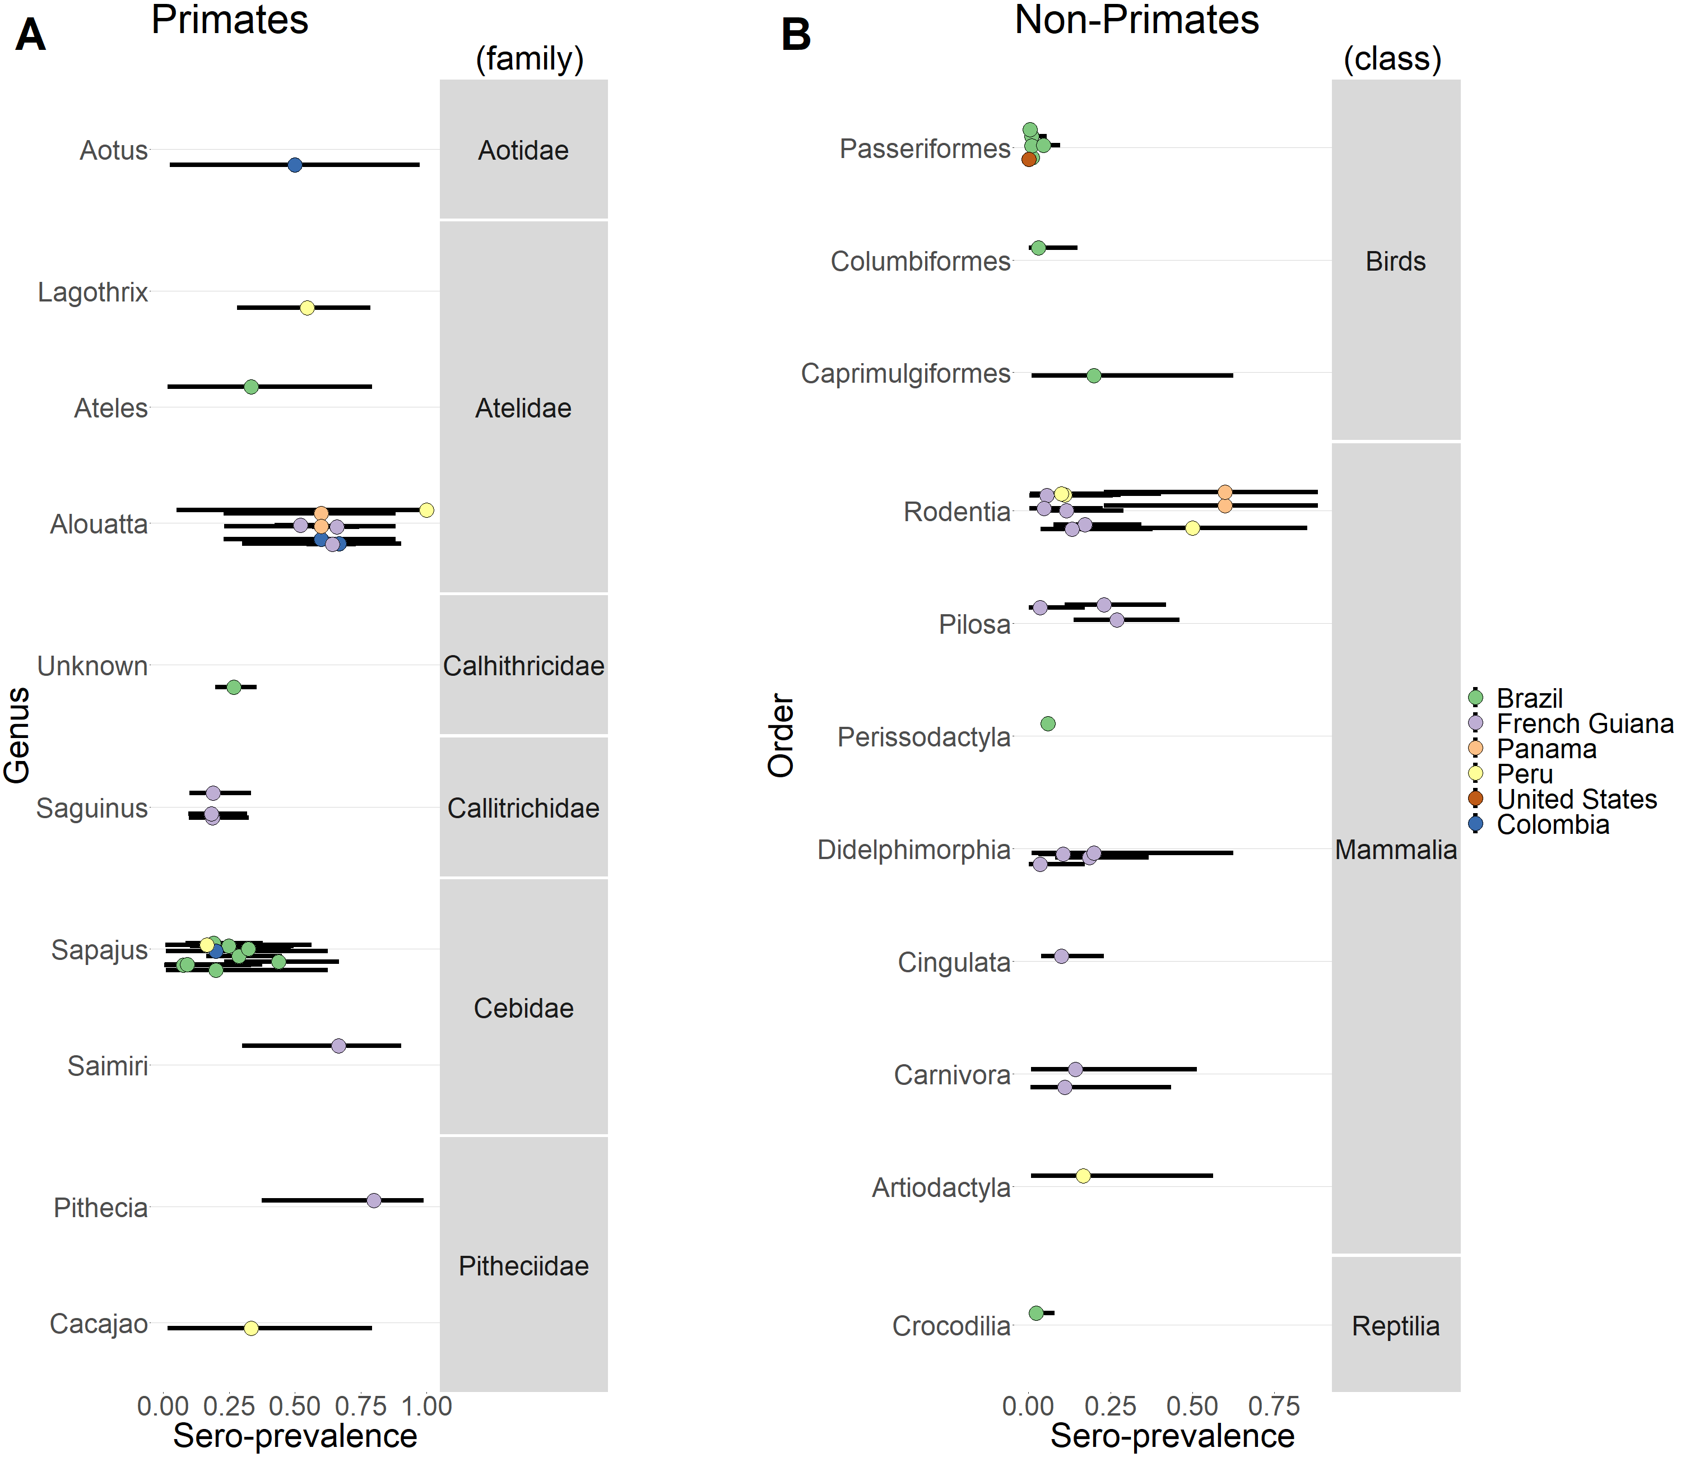
Other animals
Seroprevalence
Seroprevalence

